Slide 1
Recap
Analysis of immune receptor of scRNA seq
filter
normalize
calculate log values
highly variable genes
pca
chain qc
calculate neighbors
umap
clusters - leiden
Visualization
DGE
GSEA

Slide 2
Vdj annotation/ immune receptor annotation
what?
VDJ annotation refers to the process of identifying and characterizing the variable (V), diversity (D), and joining (J) gene segments within the immunoglobulin (Ig) or T-cell receptor (TCR) gene loci.
why?
The VDJ annotation process involves using tools to align and compare sequences from a genomic or transcriptomic dataset to a reference database of known V, D, and J gene segments. This allows for the identification of the specific V, D, and J segments used in the generation of each individual antigen receptor sequence.
details about contig annotation of immune receptor
Tools used -
Igblast - wrapper - pyIR
Cell Ranger

Slide 3
igblast
IgBLAST uses a customized version of the basic local alignment search tool (BLAST) algorithm to align the input sequences with a database of germline V, D, and J gene segments. This allows for the identification of the specific V, D, and J gene segments used in the generation of each individual antigen receptor sequence.It also identifies somatic mutations, identifying isotype/subtype and subclass, determining complementarity-determining region (CDR) lengths, and identifying potential non-functional sequences.
Input - fasta format

Slide 4
Preprocessing: IgBLAST first preprocesses the input sequences by removing low-quality regions, trimming the sequences to remove adapters, and converting them to the appropriate format.
Alignment: IgBLAST then performs a sequence alignment between the input sequence and the germline V, D, and J gene segments. This alignment uses a customized version of the basic local alignment search tool (BLAST) algorithm that is optimized for Ig and TCR sequences.
Filtering: IgBLAST filters out low-quality alignments, including those with short or poorly aligned sequences, to ensure that only high-quality alignments are used for V(D)J sequence annotation.
Annotation: Based on the alignment results, IgBLAST identifies the specific V, D, and J gene segments used in the generation of each individual antigen receptor sequence. It also identifies the CDR and framework regions (FR) in each sequence.
Clustering: IgBLAST can also perform clustering to group similar sequences together, which can be useful for identifying clonal expansions in a sample.
Output: Finally, IgBLAST provides a range of output formats for the annotated sequences, including tabular and FASTA formats. It also provides additional information on the isotype/subtype, somatic mutations, and CDR lengths of each sequence.

Slide 5
PyIR
PyIR is a minimally-dependent high-speed wrapper for the IgBLAST immunoglobulin and T-cell analyzer.
It achieves this through chunking the input data set and running IgBLAST . At the beginning of execution, PyIR estimates the number of input sequences based on the FASTX file size and then splits the file into ‘chunks’ that are stored as temporary files on disk. This allows PyIR to process billions of immunoglobulin and T cell receptor sequences using IgBLAST.

Slide 6
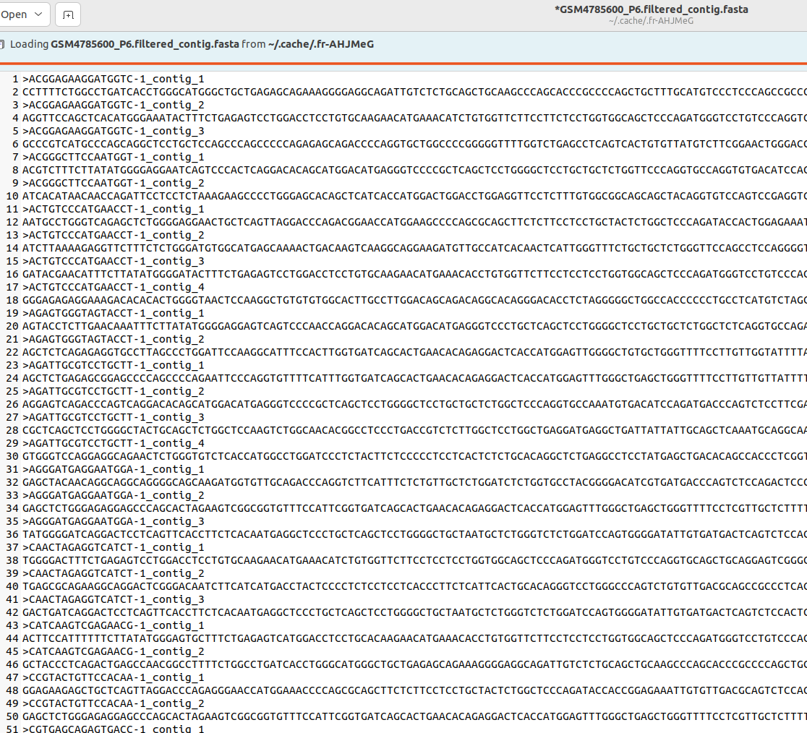
Input

Slide 7
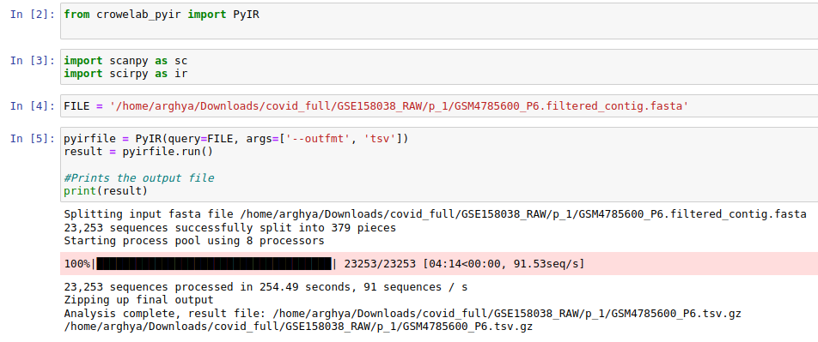
Processing

Slide 8
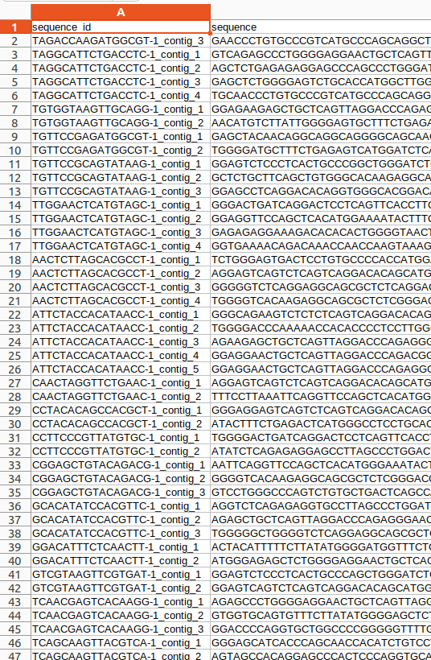
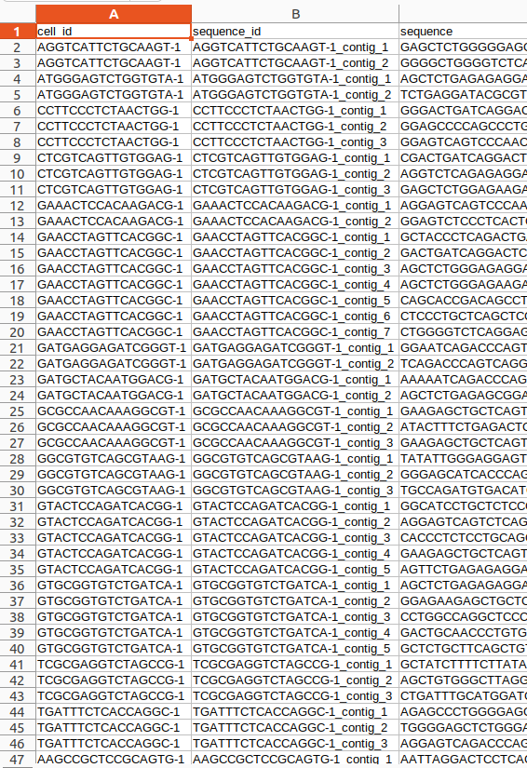
Output
Manually added cell_id from seq_id

Slide 9
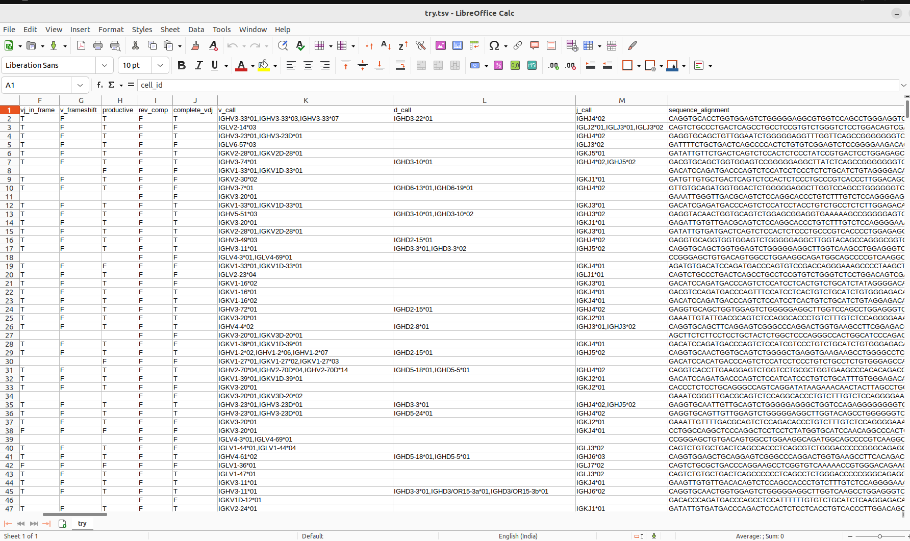

Slide 10
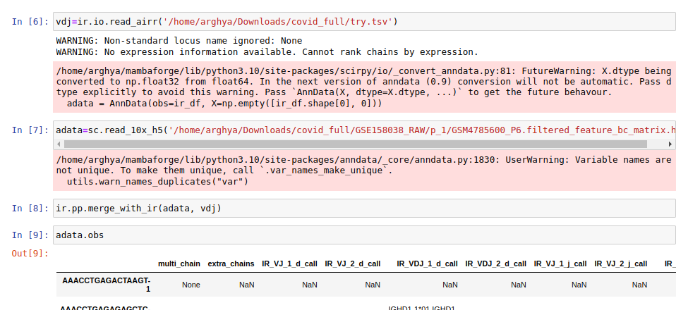
Lastly, merge the contig annotation obtained with feature_bc_matrix in an anndata object ; remove null values, filter and proceed to analysis

Slide 11
Cell ranger vdj pipeline
used to analyze sequencing data produced from Chromium Single Cell 5′ V(D)J libraries. It takes FASTQ files from cellranger and performs sequence assembly and paired clonotype calling. The pipeline uses the Chromium cellular barcodes and UMIs to assemble V(D)J transcripts per cell.
Input - FASTQ from cellranger

Slide 12
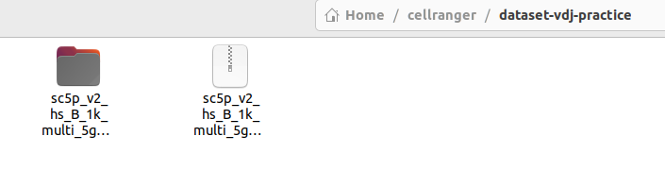
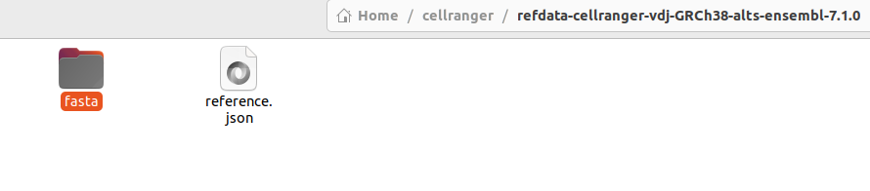
vdj annotation processing from tutorial dataset
Dataset used from 10x genomics
Ref dataset - Human - GRCH38

Slide 13
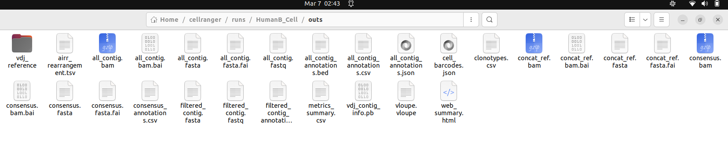
Output

Slide 14
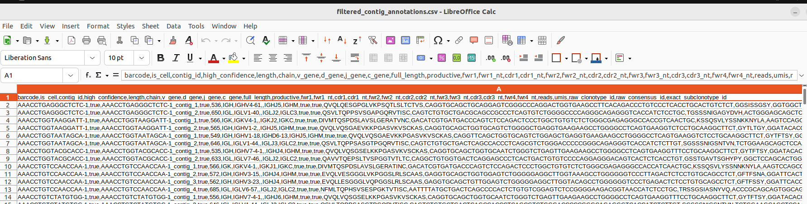
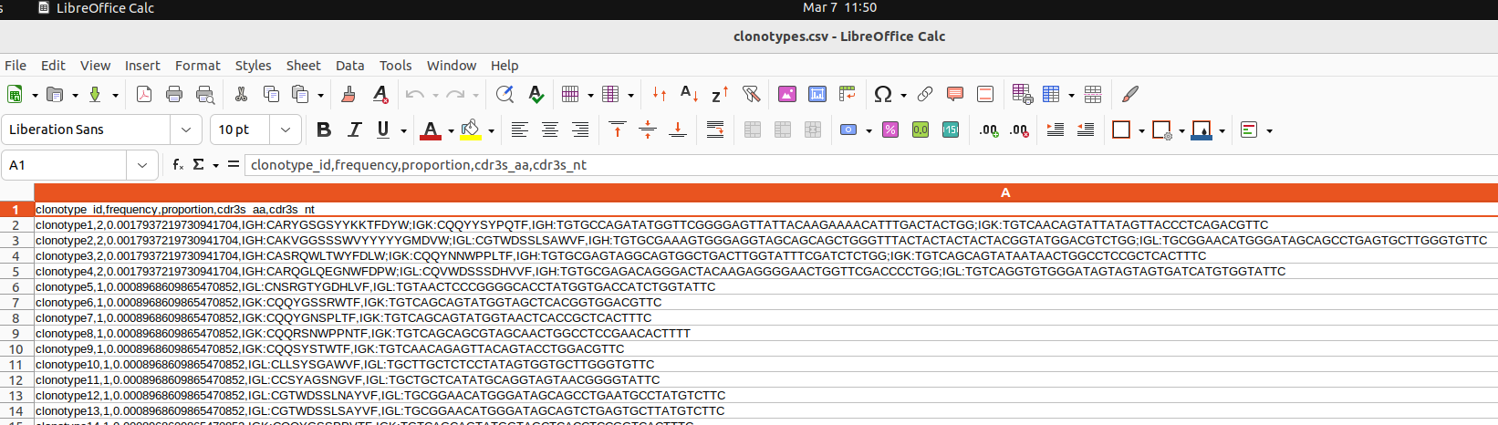
Filtered contig annotation - of cell ranger(outs)
Clonotype - of cell ranger(outs)

Slide 15
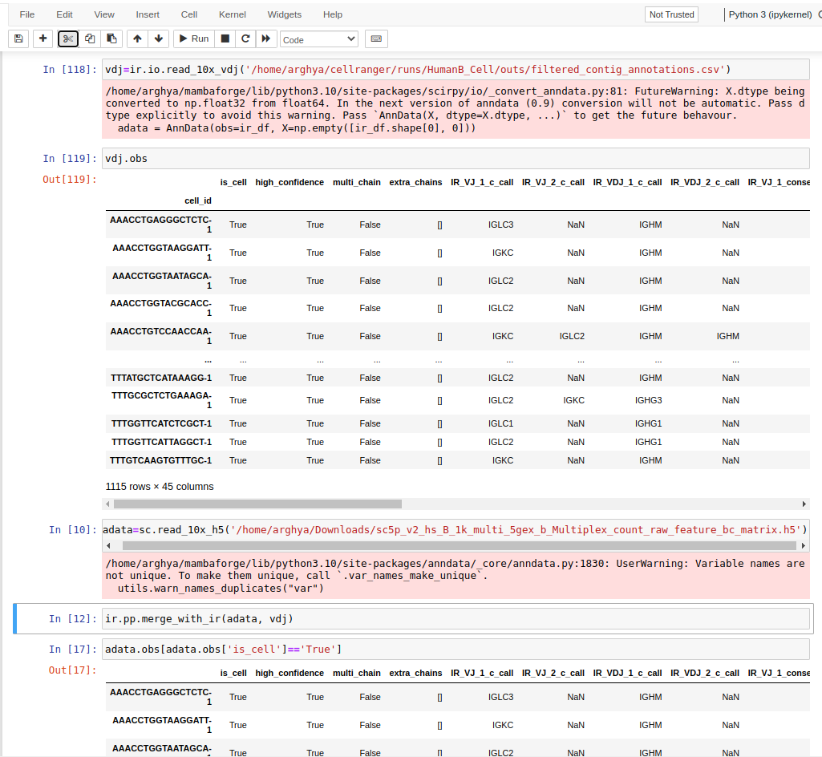
The output consists of the given files above.
Out of these, we will be using
Filtered contig annotation(containing the
vdj annotation)
And the feature file directly
from cell ranger
And merge to form an
anndata object

Slide 16
Feature | Cell Ranger VDJ Pipeline | IgBLAST VDJ Pipeline
Software requirements | Cell Ranger | IgBLAST, IMGT
Input data types | 10x Genomics single-cell and bulk RNA-seq data | FASTQ files
Input data format | BAM or MEX files | FASTA files
Species compatibility | Human and mouse | Broad range of species
Library preparation | 5' and 3' | 5' and 3'
V(D)J gene identification | Cell Ranger algorithm | IgBLAST
Repertoire annotation | Cell Ranger algorithm | IgBLAST and IMGT
Repertoire analysis | Seurat, Loupe VDJ, VDJTools | python

Slide 17
Next steps…………
Counts to vdj annotation
Provided with -
Barcode.tsv, matrix.mtx and feature.tsv
Get the VDJ annotation.
Integrate bcr tcr data with counts file

